Slide 1


Machine Learning
Ensemble Learning
Lecturer: PhD Trần Lương Quốc Đại
Members:
Mai Hoàng Thái - 523H0177
Nguyễn Trần Hoàng Nhân - 523H0164

Slide 2

Table of Contents
Introduction
Bagging
Boosting
Stacking
Comparision
Conclusion

Slide 3
Ensemble Learning
Introduction

Slide 4
Ensemble Learning
Introduction
The Problem: Bias-Variance Tradeoff
Concept: In supervised learning, the prediction error consists of three parts: Bias, Variance, and Irreducible Error.
High Bias (Underfitting): The model is too simple to capture the underlying structure of the data.
High Variance (Overfitting): The model is too sensitive to the noise in the training data.
The Tradeoff: Typically, minimizing bias increases variance and vice versa.
Equation:

Slide 5
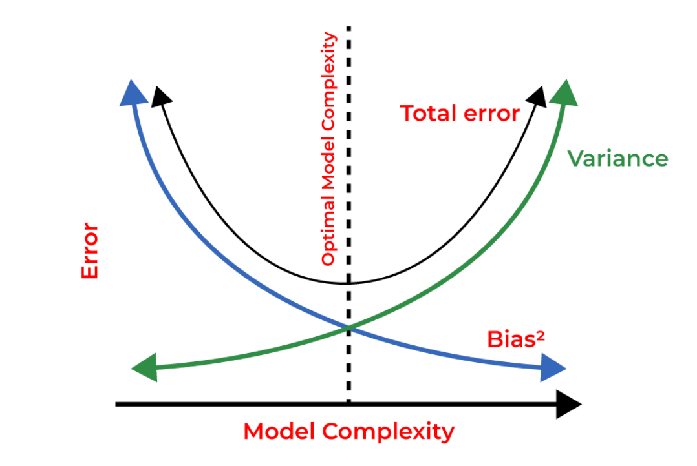
Ensemble Learning
Introduction
The Problem: Bias-Variance Tradeoff

Slide 6
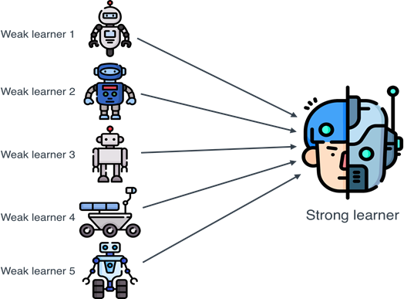
Ensemble Learning
Introduction
The Solution: Using Ensemble Learning
Bagging: Primarily focuses on reducing Variance (effective for high-variance models like Decision Trees).
Boosting: Primarily focuses on reducing Bias (effective for weak learners with high bias).
Stacking: Primarily focuses on improving predictive accuracy by combine boosting bagging.

Slide 7
Ensemble Learning
Introduction
What is Ensemble Learning?
Definition: A machine learning paradigm where multiple models (called "base learners" or "weak learners") are strategically combined to create a single, more powerful predictive model
Philosophy: Based on the "Wisdom of Crowds" or "Collective Intelligence"-a committee of experts often makes better decisions than any single expert.

Slide 8
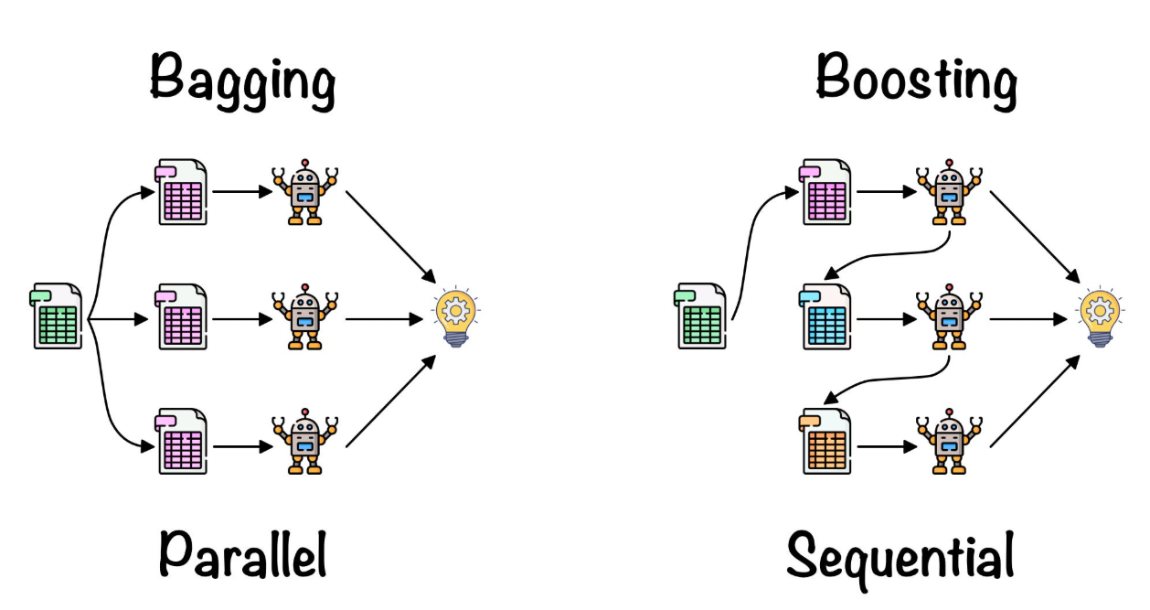
Ensemble Learning
Introduction
What is Ensemble Learning?

Slide 9
Ensemble Learning
Introduction
Goal of Ensemble Learning
To create a Strong Learner from multiple Weak Learners.
To improve generalization capability and robustness compared to individual models.
How Ensemble Helps
Error Reduction: Random errors cancel out while systematic correct predictions reinforce each other.
Stability: Reduces the risk of choosing a single poor model.

Slide 10
Ensemble Learning
Bagging

Slide 11

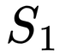
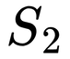
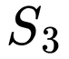
Ensemble Learning
Bagging
Theoretical Framework
Bootstrap Sampling (The "Bag" part):
1
2
3
4
5
6
1
2
1
2
4
6
3
3
4

Slide 12
Ensemble Learning
Bagging
Theoretical Framework
Bootstrap Sampling (The "Bag" part):
Out-of-Bag (OOB):
When we create a Bootstrap sample (the "bag"), we pick data randomly with replacement.
Because of this, approximately 36.8% of the original data is never selected for a specific model.
These "leftover" samples are called Out-of-Bag (OOB) samples. We use them to test the model immediately.
It acts as a built-in validation set. You get an unbiased error estimate "for free" without needing a separate cross-validation step.

Slide 13
Ensemble Learning
Bagging
Theoretical Framework
Parallel Training:
This is the biggest technical advantage of Bagging over other methods.
Independence: In Bagging, sub-models (base learners) are trained on different subsets of data. Model A does not need the output of Model B. They are completely independent.
Models are trained in parallel.
→ Helps to significantly reduce training time, especially when the data is large and the model is complex.

Slide 14
Ensemble Learning
Bagging
Theoretical Framework
Aggregation:
Aggregation is the step where we consult to make the final decision:
For Regression
For Classification

Slide 15
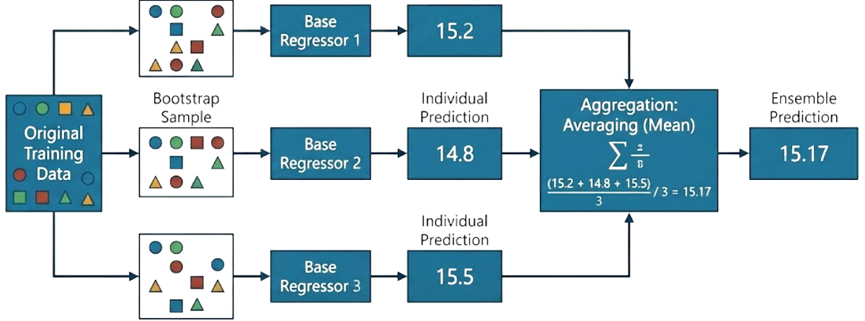
Ensemble Learning
Bagging
Theoretical Framework
For Regression: The final result is the average of all the predictions from the sub-models.

Slide 16
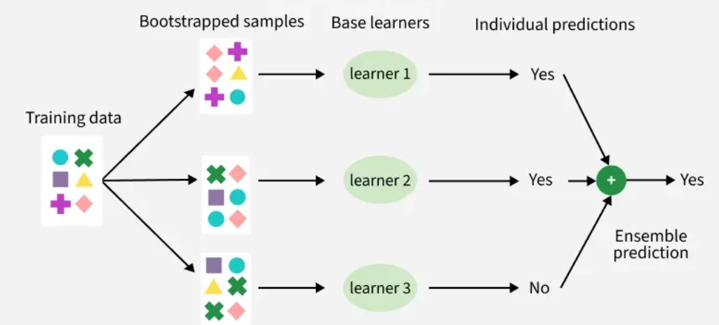
Ensemble Learning
Bagging
Theoretical Framework
For Classification: The most common method is Voting:
Hard Voting: Each model votes for 1 class label.
Soft Voting: The models give probabilities for each class. The system will average those probabilities and choose the class with the highest average probability.

Slide 17
Ensemble Learning
Bagging
Why Bagging Reduces Variance?
Bagging reduces Variance because it follows the statistical principle: "Random errors cancel each other out when added together."
Independent: Due to Bootstrapping, individual base models produce random and distinct errors.
Cancellation: When combined, the positive errors from one model are compensated for by the negative errors of another.
Result: The final output captures the most accurate "central tendency," remaining stable and less susceptible to noise.

Slide 18
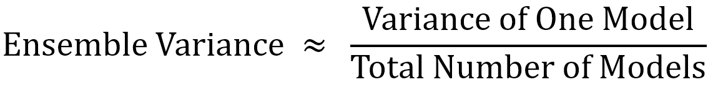
Ensemble Learning
Bagging
Why Bagging Reduces Variance?
Variance Reduction Formula:
(Note: This assumes models are perfectly independent)

Slide 19
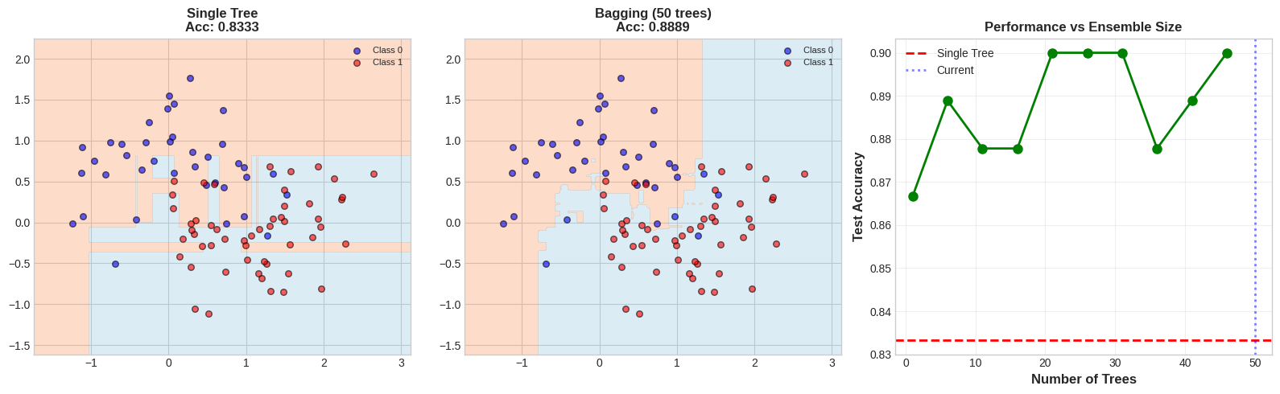
Ensemble Learning
Bagging
Visualization
Current configuration: 50 trees
Single tree accuracy: 0.8333
Bagging accuracy: 0.8889
Improvement: +5.56%
Boundary is much smoother than single tree!

Slide 20
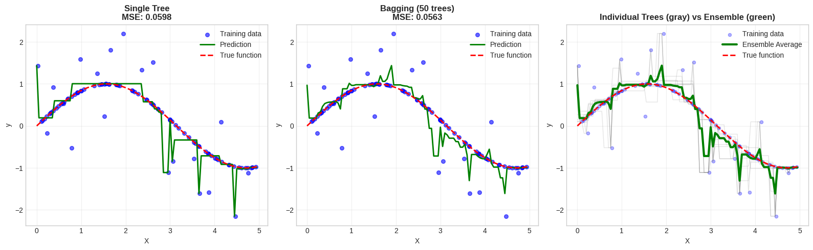
Ensemble Learning
Bagging
Visualization
Current configuration: 50 trees
Single tree MSE: 0.0598
Bagging MSE: 0.0563
MSE reduction: 5.85%
Notice: Bagging moderately smooths the prediction!

Slide 21
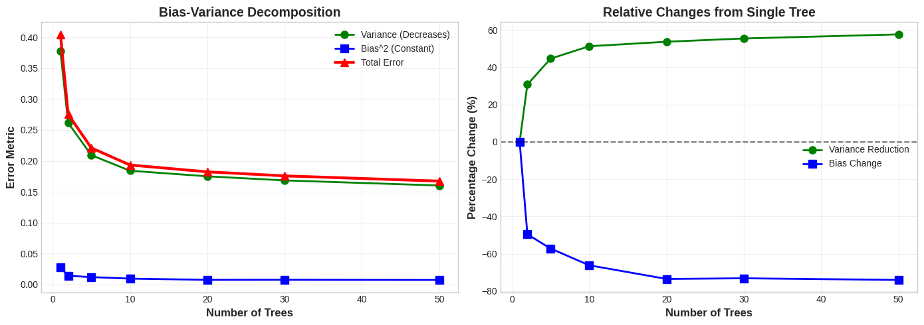
Ensemble Learning
Bagging
Visualization
Variance reduced by: 57.58%
Bias changed by: -74.03%
Total error reduced by: 58.70%
CONCLUSION: Bagging reduces VARIANCE without increasing BIAS!

Slide 22
Ensemble Learning
Bagging
Random Forest
The Foundation: Random Forest is Bagging applied to Decision Trees.
The Problem of Bagging:
Tree Correlation: If the data has strong features, all trees will select them at the root.
Result: The trees become structurally identical, limiting the reduction of variance.
The Random Forest "Twist":
Random Feature Selection: At each split, the tree is forced to consider only a random subset of features.
Effect: This forces trees to be different, further reducing variance.

Slide 23
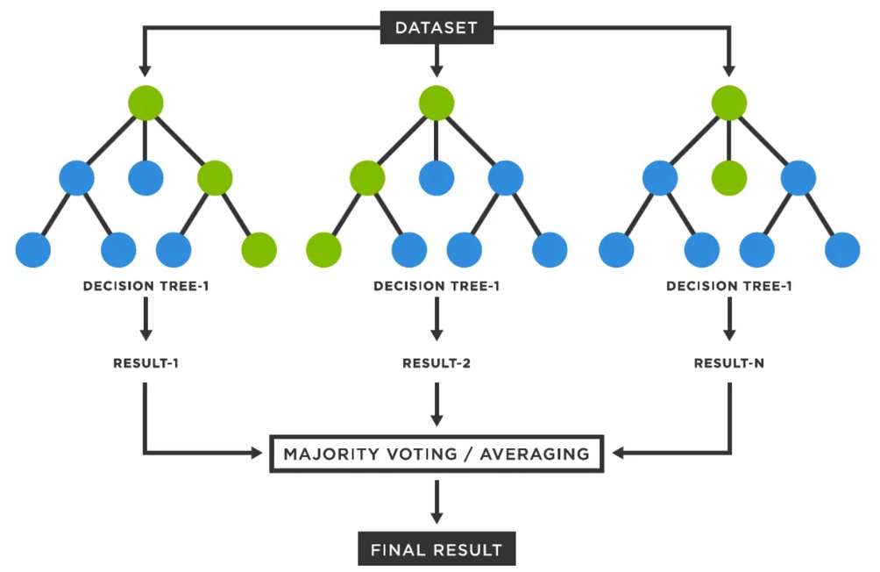
Ensemble Learning
Bagging
Random Forest
The Formula:
Result: The trees are forced to be more diverse, which reduces Variance more strongly than Normal Bagging.

Slide 24
Ensemble Learning
Boosting

Slide 25
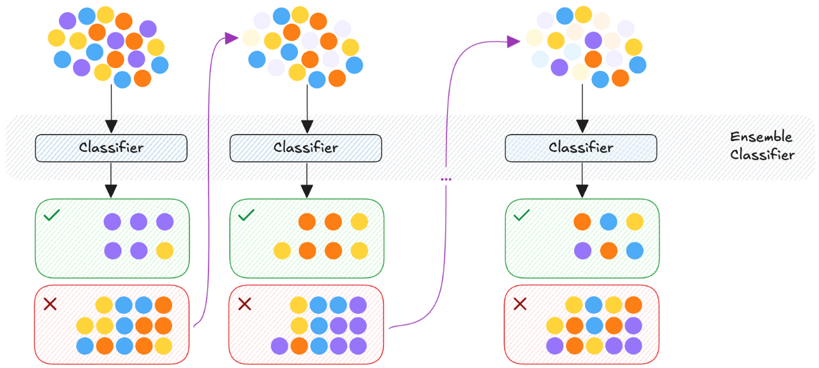
Ensemble Learning
Boosting
Theoretical Framework
Boosting is a sequential technique. Unlike Bagging (parallel), Boosting builds models one after another, where each new model tries to fix the mistakes of the previous one.

Slide 26
Ensemble Learning
Boosting
Why Boosting Reduces Bias?
Sequential Error Correction:
Boosting does not fit a single complex model at once.
Instead, it fits a sequence of weak models iteratively.
Key Mechanism: Every new model is trained specifically to fix the bias of the previous combined model.

Slide 27
Ensemble Learning
Boosting
Why Boosting Reduces Bias?
Increasing Model Complexity:
Base Models: We start with weak Learners which have High Bias.
The Ensemble: By summing up many simple corrections, the final ensemble becomes a highly complex function capable of fitting very non-linear data boundaries.
This transforms a High Bias system into a Low Bias system.

Slide 28
Ensemble Learning
Boosting
AdaBoost
Mechanism: "Learning via Weights"
Initially, all data points have equal weights.
After training Model 1, the weights of misclassified examples are increased.
Model 2 is forced to focus on these "hard" examples (high-weight points).
Aggregation:
Final prediction is a weighted vote.
More accurate models get higher voting power.

Slide 29
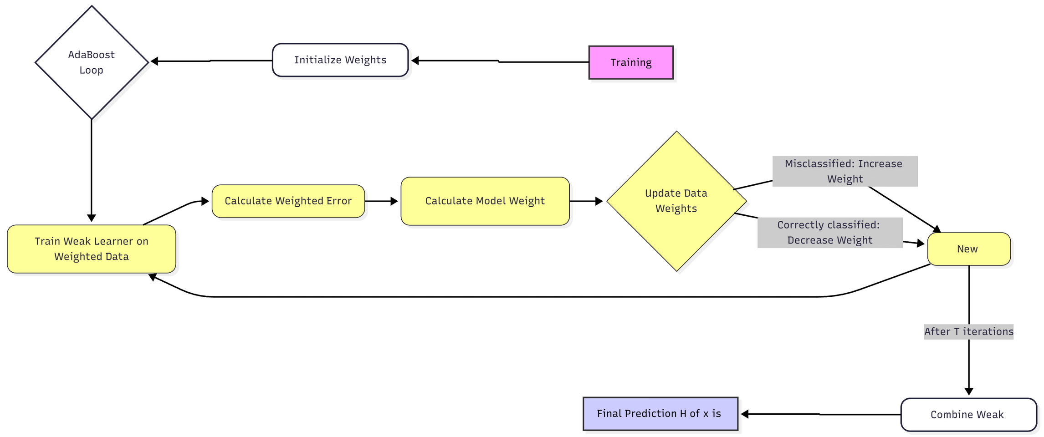
Ensemble Learning
Boosting
AdaBoost

Slide 30
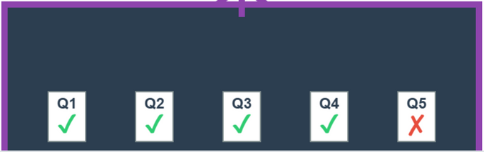
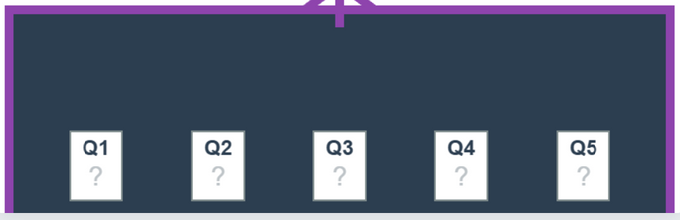
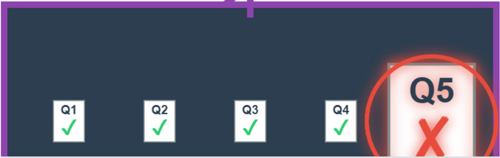
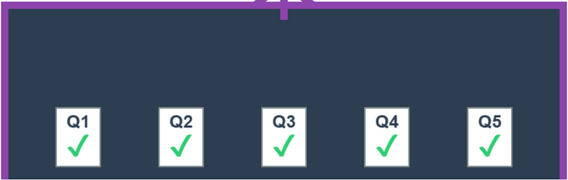
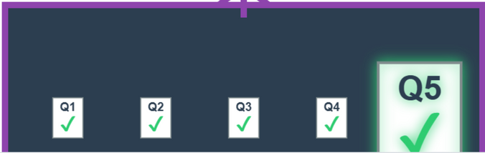
Ensemble Learning
Boosting
AdaBoost
Student fail at question 5
Example:
Teacher give the test
→
Focus on question 5
→
>
→
Student can do correctly all question
Student now solve question 5 correctly
→

Slide 31
Ensemble Learning
Boosting
AdaBoost
Mathematical Foundation
AdaBoost Algorithm Step by Step:
Step 1: Initialize weights, all N samples initially have equal weights
Step 2: For each iteration:
Train weak learner on data with weights
Calculate weighted error rate
Calculate model weight
Update sample weights
Normalize weights
Step 3: Final Prediction

Slide 32
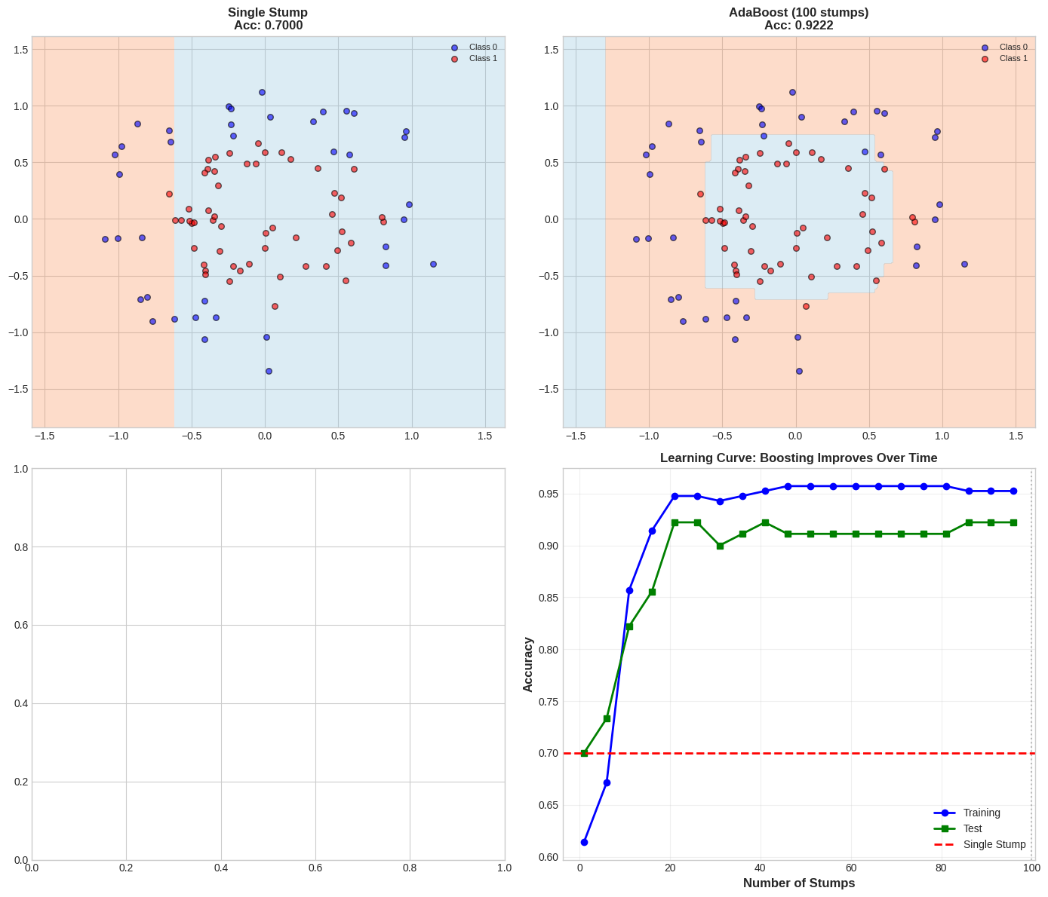
Ensemble Learning
Boosting
AdaBoost
Visualization
Current: 100 stumps
Single stump: 0.7000
AdaBoost: 0.9222
Improvement: +22.22%

Slide 33
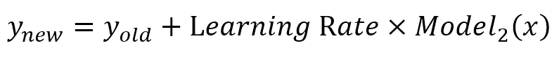
Ensemble Learning
Boosting
Gradient Boosting
Mechanism: "Learning via Errors"
Instead of changing sample weights, the new model tries to predict the error of the previous model.
It uses Gradient Descent to minimize a Loss Function.
The Process:
Model 1 predicts the average.
Calculate Residual: R = y_true - y_pred.
Model 2 predicts R.
Update:

Slide 34
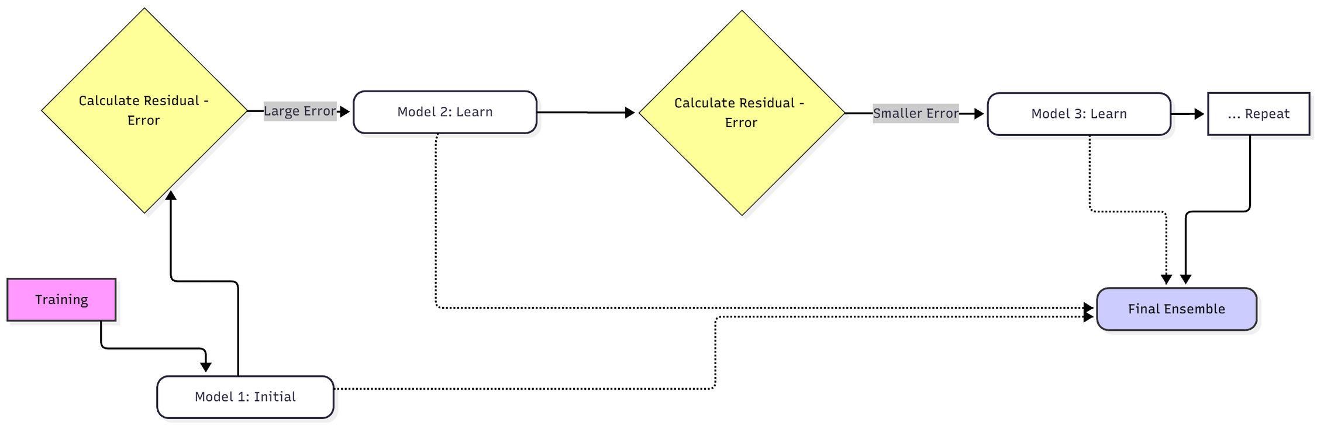
Ensemble Learning
Boosting
Gradient Boosting

Slide 35
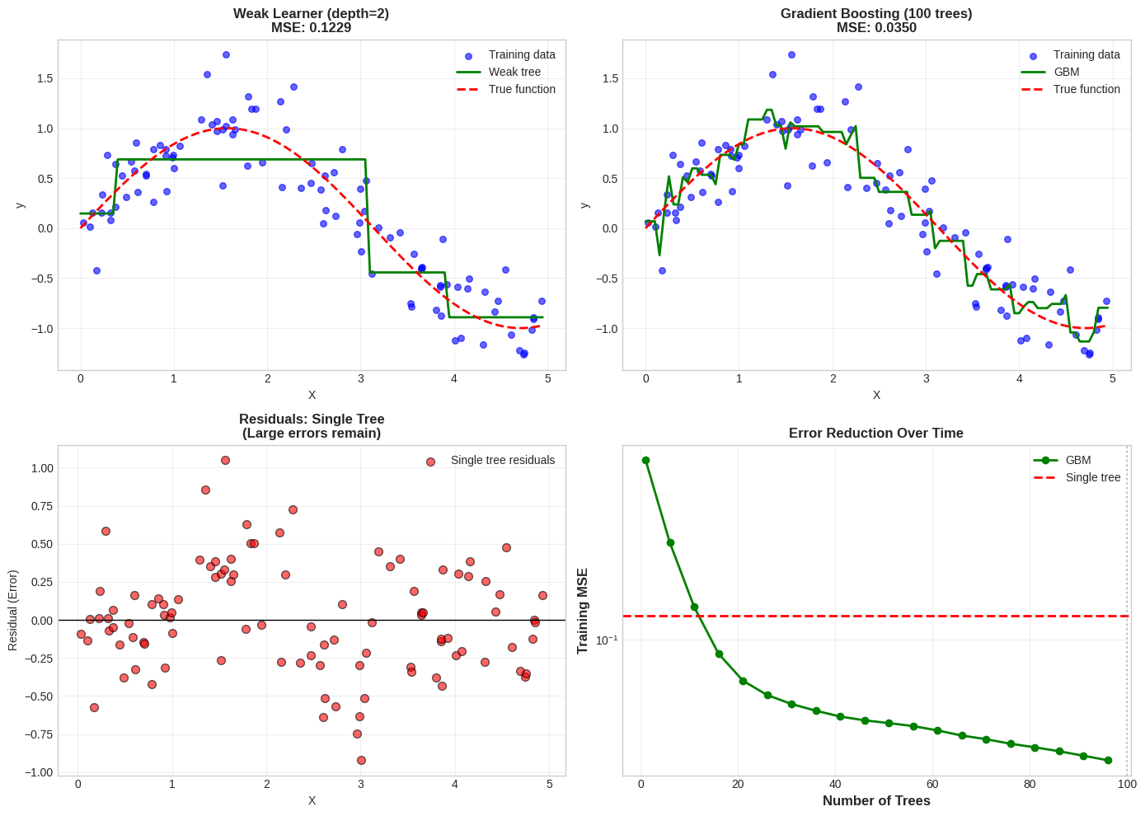
Ensemble Learning
Boosting
Gradient Boosting
Visualization
Current: 100 trees
Single tree MSE: 0.1229
GBM MSE: 0.0350
MSE reduction: 71.54%
GBM fits residuals iteratively, reducing bias each step!

Slide 36
Ensemble Learning
Boosting
Modern Implementations
XGBoost (Extreme Gradient Boosting):
Optimized for speed and performance.
Includes regularization (L1/L2) to prevent overfitting.
LightGBM:
Developed by Microsoft. Uses leaf-wise tree growth.
Extremely fast and memory-efficient for large datasets.
CatBoost:
Developed by Yandex.
Handles Categorical Features automatically without complex preprocessing.

Slide 37
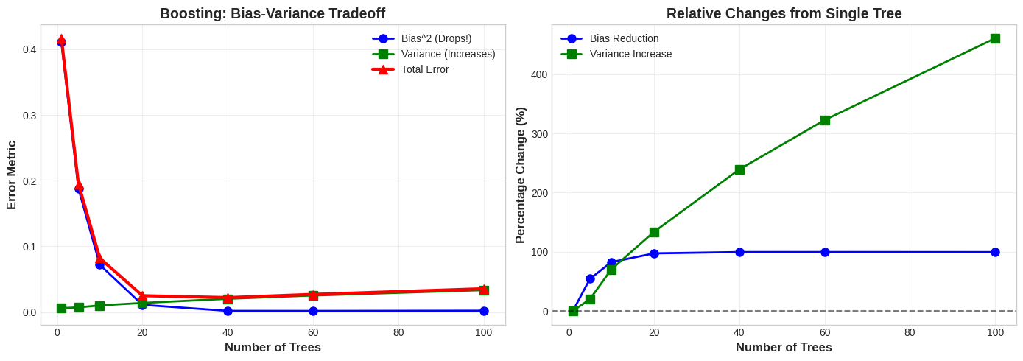
Ensemble Learning
Boosting
Visualization
Bias reduced by: 99.49%
Variance increased by: 461.13%
Net effect: Total error reduced by 91.48%
CONCLUSION: Boosting reduces BIAS but increases VARIANCE!
This is opposite to Bagging.

Slide 38
Ensemble Learning
Boosting
Conclusion & Trade-offs
When to use:
When you need maximum accuracy on structured/tabular data.
When the base model has High Bias (Underfitting).
Limitations:
Sequential: Harder to parallelize than Bagging.
Noise Sensitivity: Because it tries to fix every error, it can overfit if the data has many outliers.
Tuning: Requires careful tuning of hyperparameters (Learning rate, tree depth).

Slide 39
Ensemble Learning
Stacking

Slide 40
Ensemble Learning
Stacking
What is Stacking?
Definition: An ensemble learning technique that combines multiple classification or regression models via a meta-classifier or a meta-regressor.
Core Philosophy:
Bagging uses Voting (Democracy).
Boosting uses Correction (Improvement).
Stacking uses Learning (Management).
Analogy: Imagine a team of experts (Base Models) giving their opinions. Instead of just voting, there is a Manager (Meta Model) who knows which expert is reliable in which situation and makes the final decision.

Slide 41
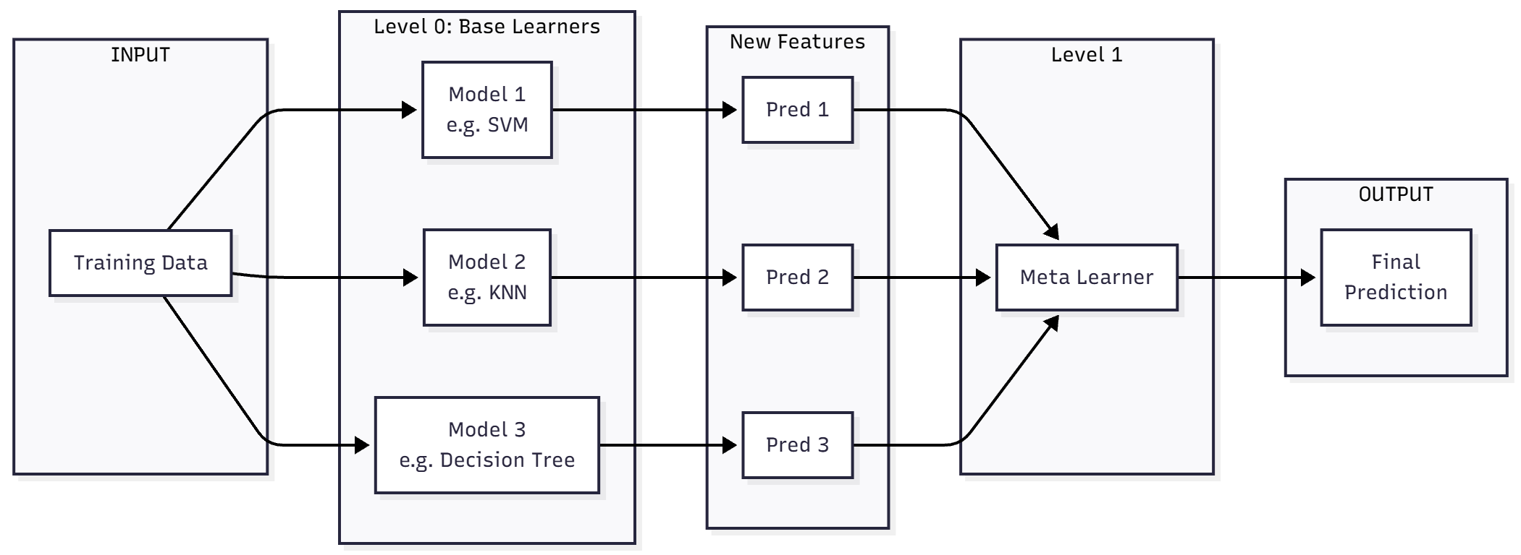
Ensemble Learning
Stacking
What is Stacking?

Slide 42
Ensemble Learning
Stacking
The Architecture
The Two-Level Structure:
Level-0 (Base Learners):
Consists of diverse models.
Key Requirement: Diversity. The models should make different types of errors.
Level-1 (Meta Learner):
Input: The predictions output by Level-0 models.
Target: The original ground truth labels.
Goal: To learn the optimal combination of base model predictions.
Common Choice: Logistic Regression or Linear Regression to keep it simple and avoid overfitting.

Slide 43
Ensemble Learning
Stacking
The Workflow
How to Train Stacking (Preventing Data Leakage)
The Problem: If we train base models and predict on the same data to train the meta-learner, it will overfit the data.
The Solution: K-Fold Cross-Validation Strategy
Split training data into K folds.
For each fold, train base models on (K-1) folds and predict on the remaining hold-out fold.
Collect these "Out-of-Fold" predictions to create a new training set for the Meta Learner.
Train the Meta Learner on these new features.

Slide 44
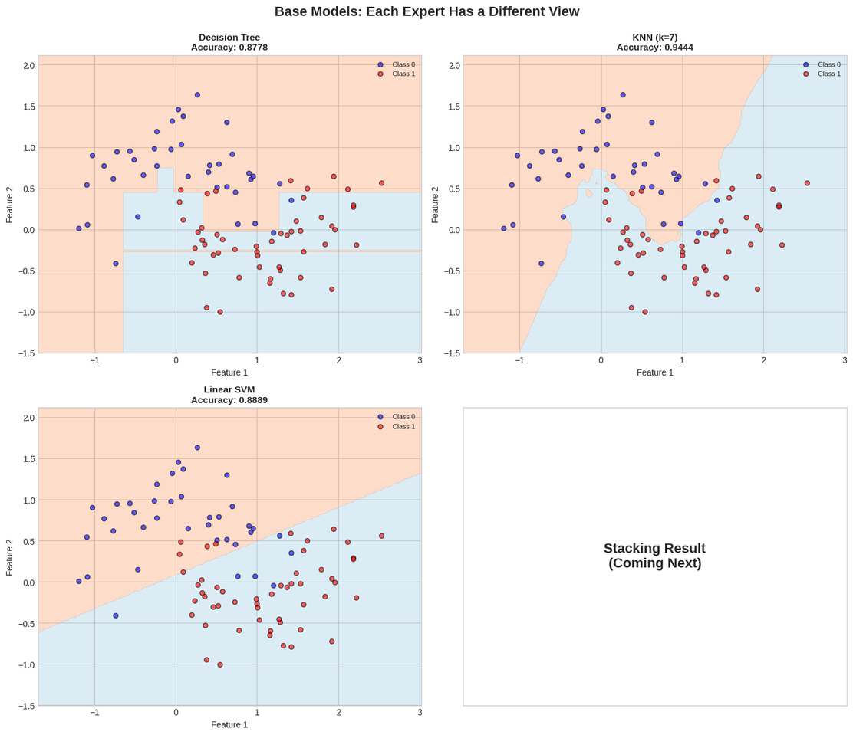
Ensemble Learning
Stacking
Visualization
Observation:
Each model creates a different decision boundary.
Stacking will learn how to combine these diverse perspectives!

Slide 45
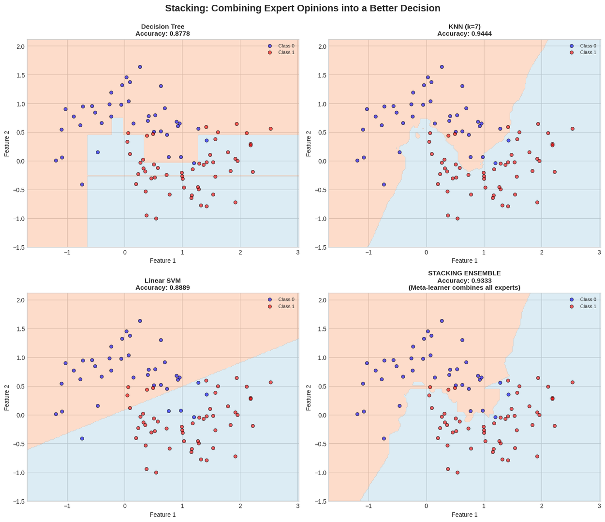
Ensemble Learning
Stacking
Visualization
NOTICE:
The stacking boundary is smoother and more accurate than individual models.
The meta-learner learned which expert to trust in different regions!

Slide 46
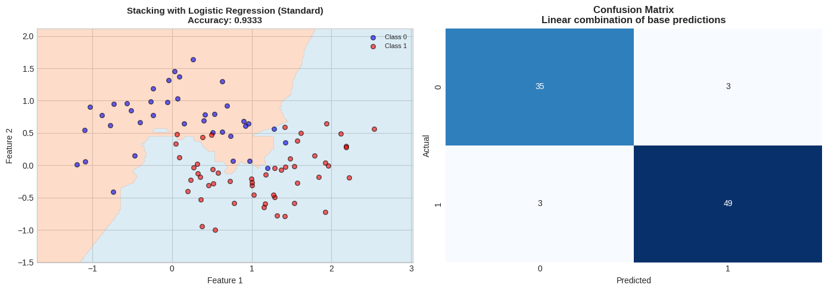
Ensemble Learning
Stacking
Visualization
Meta-Learner: Logistic Regression (Standard)
Description: Linear combination of base predictions
Accuracy: 0.9333
Comparison with base models:
vs Decision Tree: +5.56%
vs KNN (k=7): -1.11%
vs Linear SVM: +4.44%

Slide 47
Ensemble Learning
Stacking
Conclusion
Pros:
Often achieves higher accuracy than any single model or simple voting.
Standard winning strategy in competitions (Kaggle).
Cons:
High Complexity: Hard to implement and explain.
Computationally Expensive: Requires training many models multiple times.

Slide 48
Ensemble Learning
Comparison

Slide 49
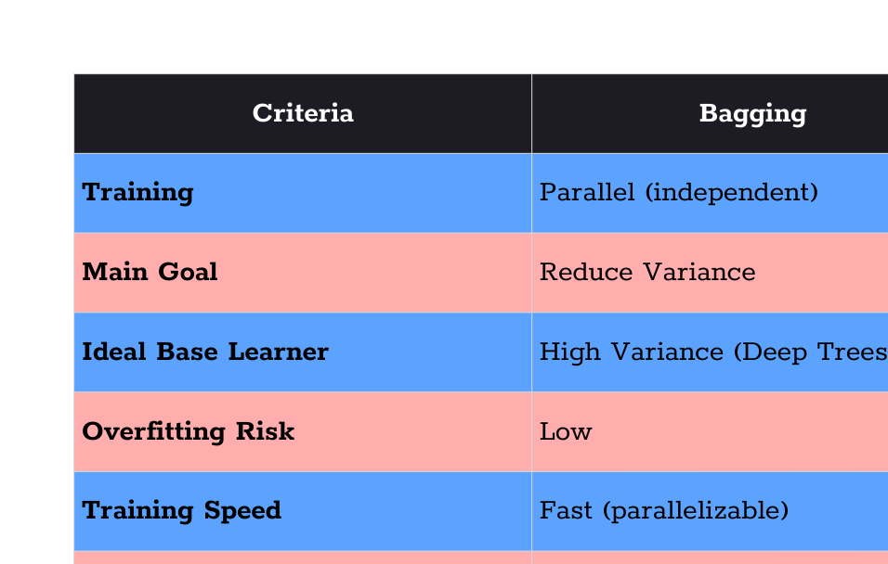
Ensemble Learning
Comparison

Slide 50
Ensemble Learning
Conclusion

Slide 51
Ensemble Learning
Conclusion
1. When to use Bagging:
You have high-variance models (like deep decision trees)
Training time is a concern (can parallelize)
Want to reduce overfitting without much tuning
Example: Random Forest for general-purpose classification
2. When to use Boosting:
You have high-bias models (weak learners)
Accuracy is more important than training time
Have clean data (less sensitive to outliers with proper tuning)
Example: XGBoost/LightGBM for Kaggle competitions
3. When to use Stacking:
You have diverse models with different strengths
Want to squeeze out maximum performance
Have enough data to properly train meta-learner
Computational cost is not a primary concern
Example: Final ensemble in competitions

Slide 52
Thanks for watching

